Slide 1
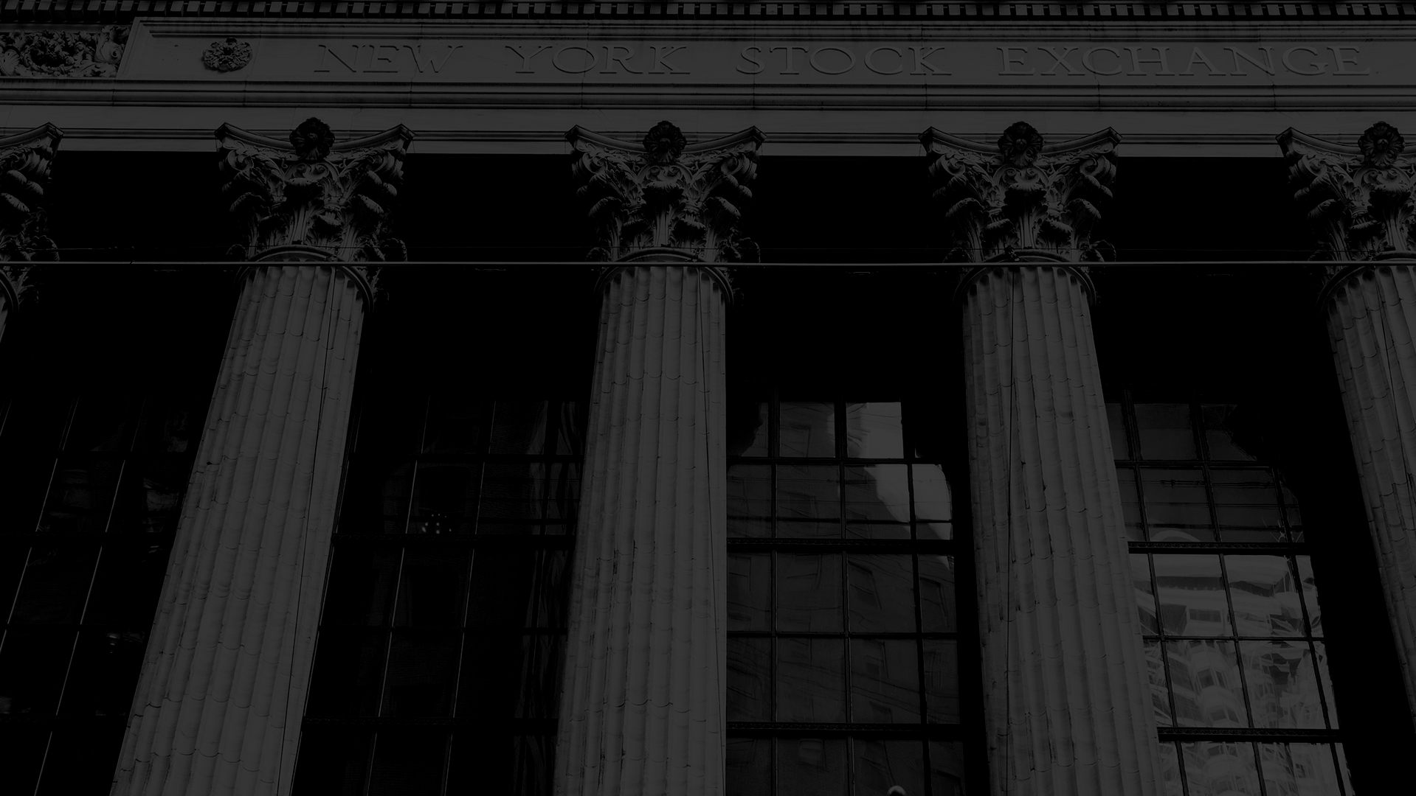
Peaceful Paradise
Project presentation

Slide 2
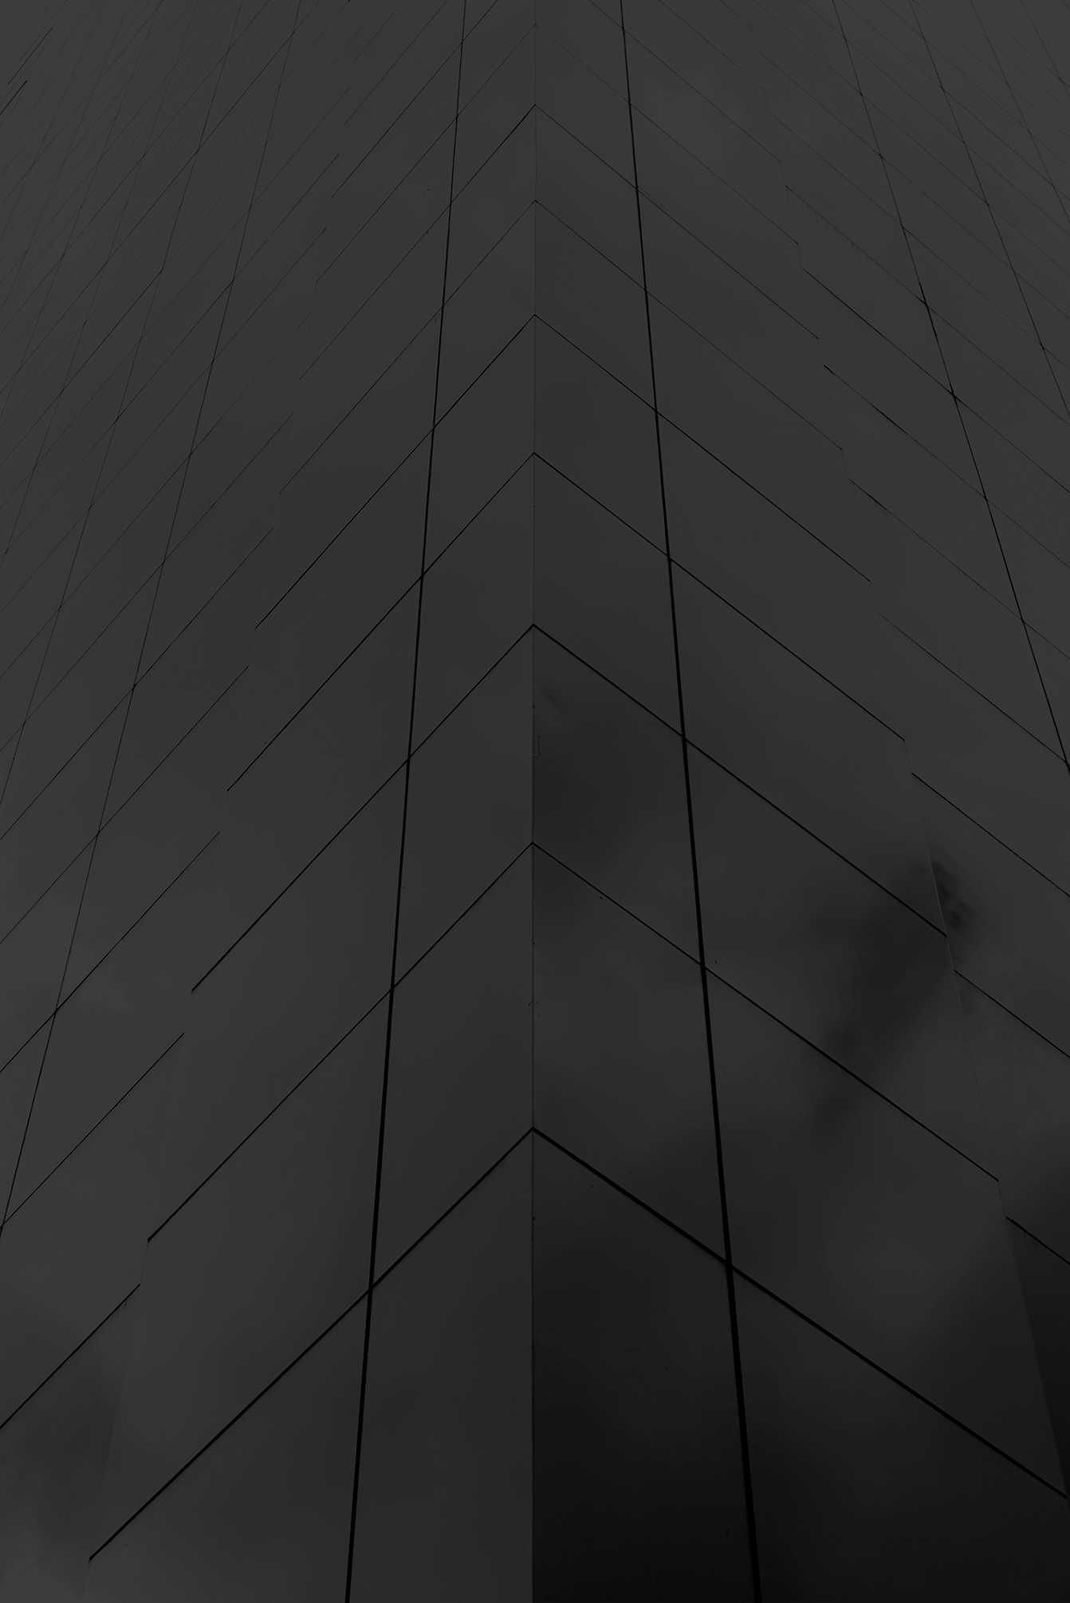

The Idea
Our logo
Hotel website
Reservation algorithm
Reception application

Slide 3


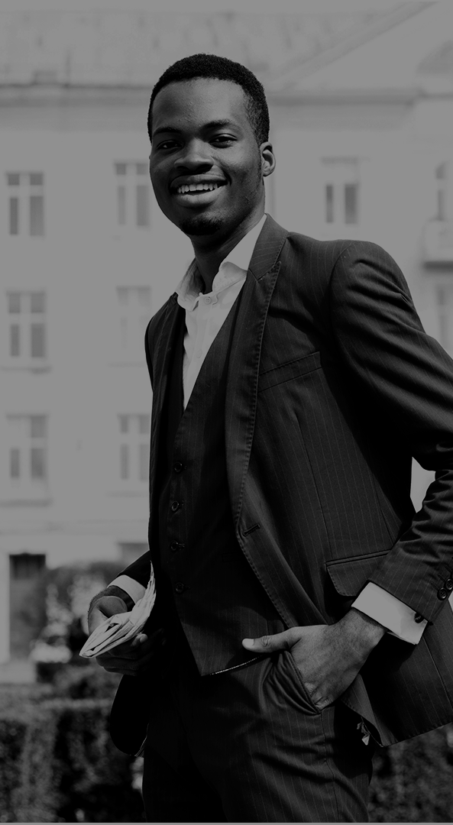
Our Team
Gábor Roncz
Reservation System
API Requests
Dávid Kálmán
Kornél Vass
Design
Sign-in, Email
Reception App
Database

Slide 4
Our Process
Step 1
Step 2
Step 3
Step 4
Step 5
Search a free room by your needs
Select the type of the room
Pick a service type
Provide your personal data
Finalize the reservation

Slide 5
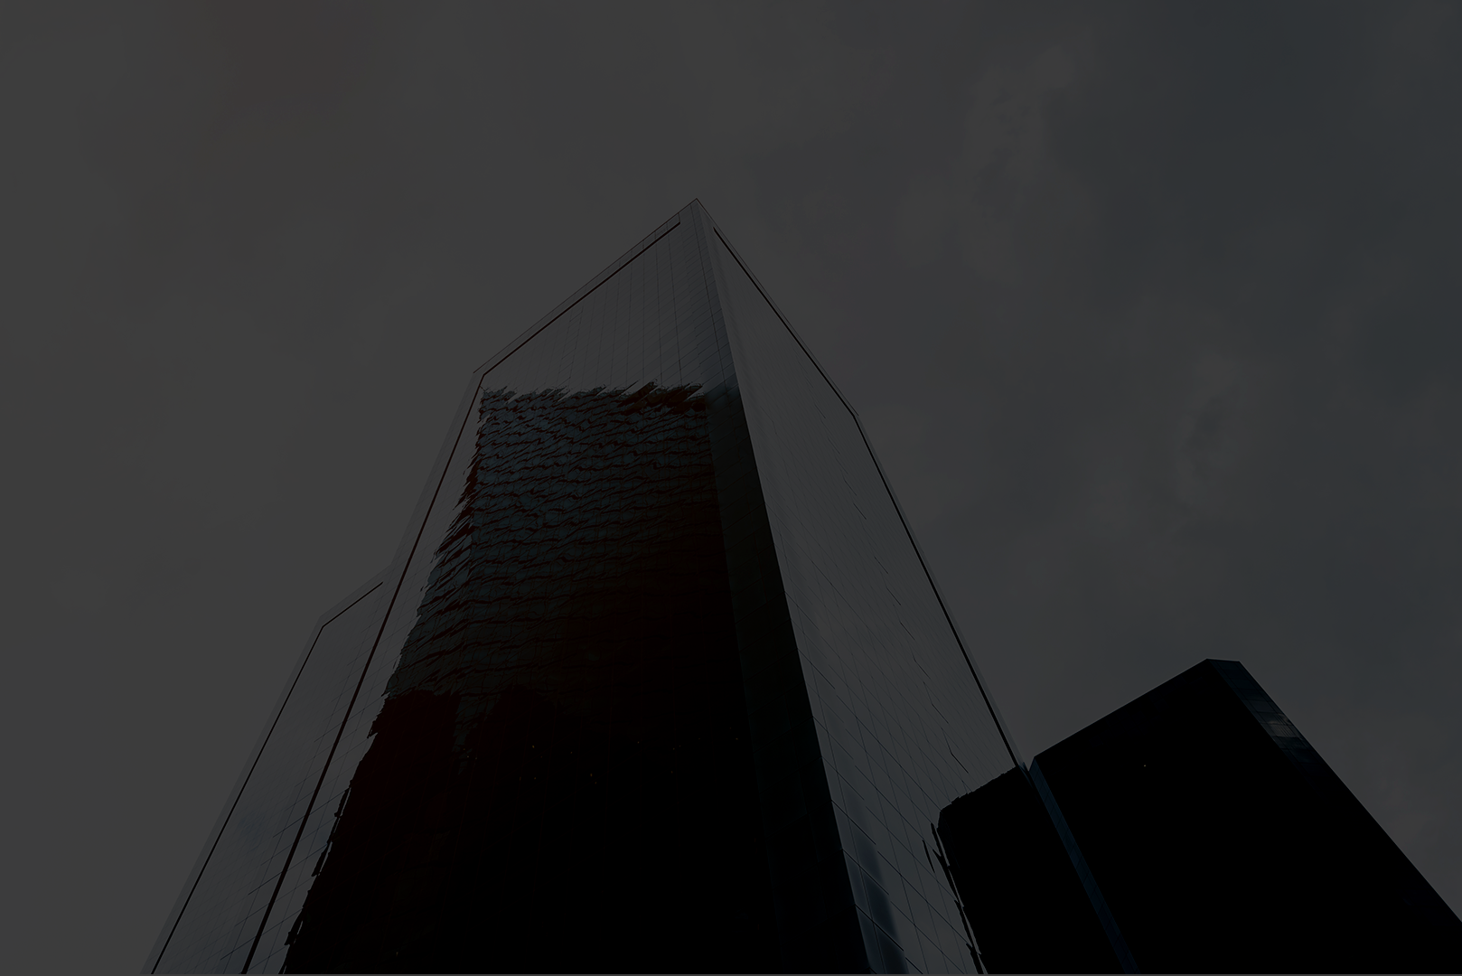
How to book a room
Search a free room by your needs
Select the type of the room
Pick a service type
Provide your personal data
Finalize the reservation

Slide 6
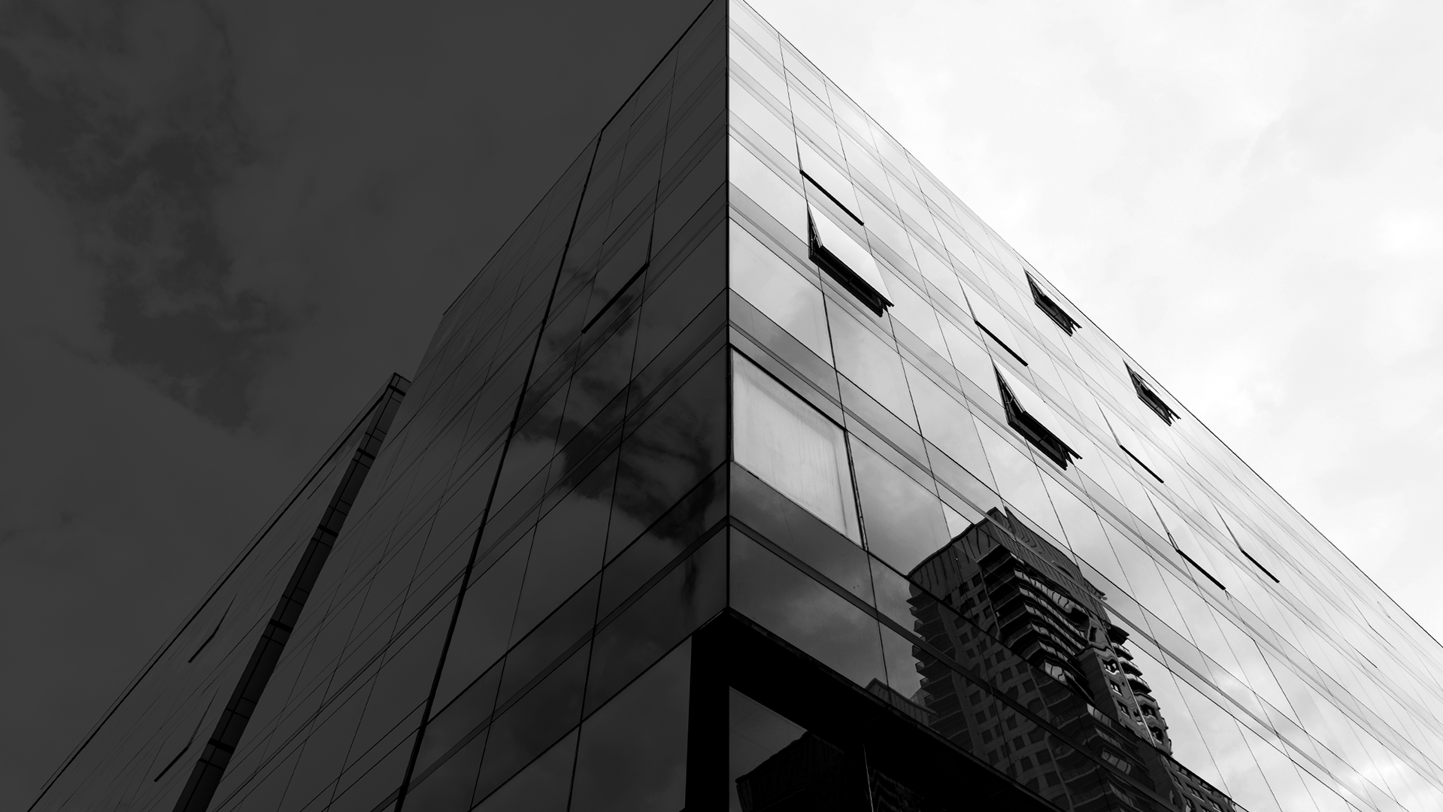
Problem
Solution
Mercury is the closest planet to the Sun and the smallest one in the Solar System—it’s only a bit larger than our Moon. The planet’s name has nothing to do with the liquid metal, since it was named after the Roman messenger god
Venus has a beautiful name and is the second planet from the Sun. It’s terribly hot—even hotter than Mercury—and its atmosphere is extremely poisonous. It’s the second-brightest natural object in the night sky after the Moon

Slide 7
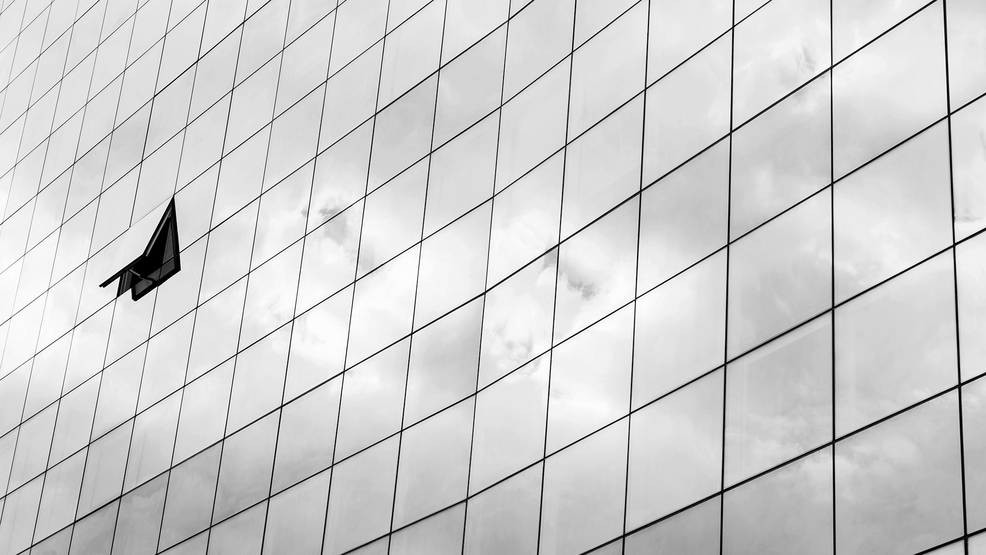
Them
Us
Mercury is the closest planet to the Sun and the smallest one in the Solar System—it’s only a bit larger than our Moon. The planet’s name has nothing to do with the liquid metal, since it was named after the Roman messenger god, Mercury
Venus has a beautiful name and is the second planet from the Sun. It’s terribly hot—even hotter than Mercury—and its atmosphere is extremely poisonous. It’s the second-brightest natural object in the night sky after the Moon

Slide 8
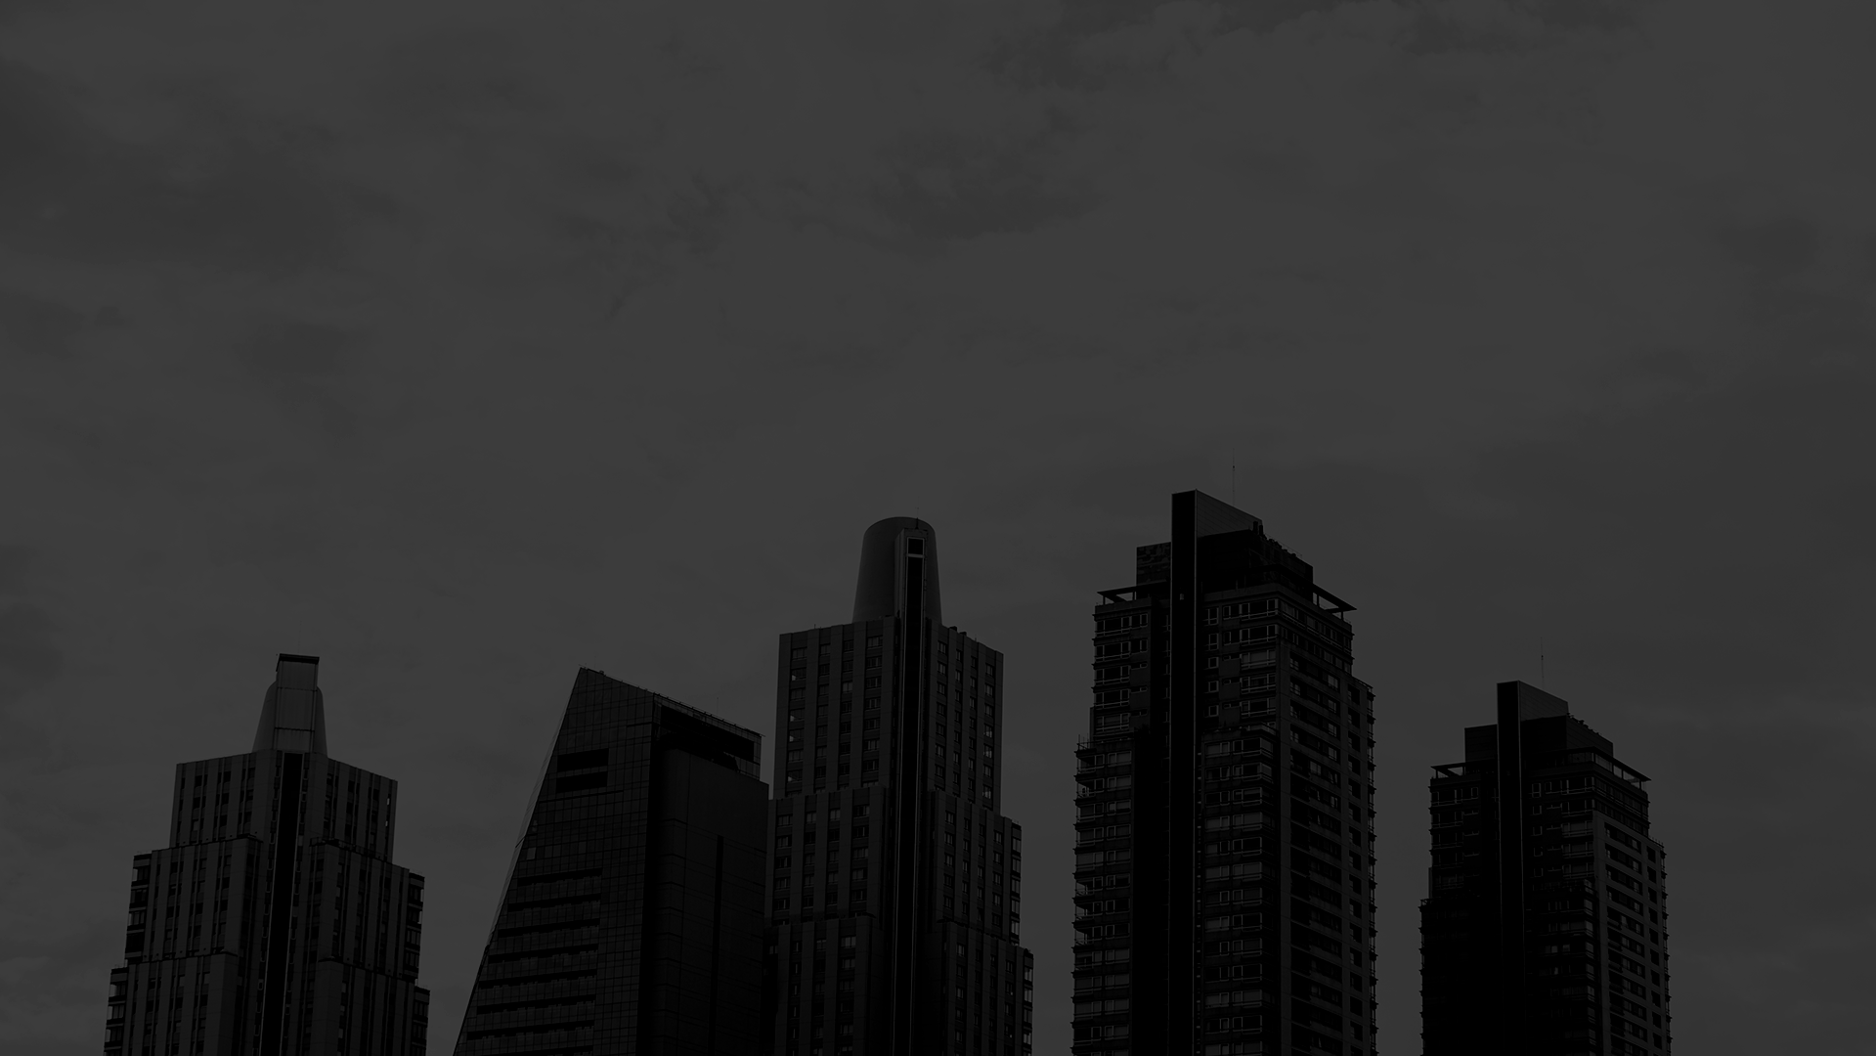
Our Plans
Basic
Pro
Premium
Despite being red, Mars is a cold place, not hot. It’s full of iron oxide dust, giving the planet its reddish cast
Yes, Saturn is the ringed one. This planet is a gas giant, composed mostly of hydrogen and helium
Jupiter is a gas giant and the biggest planet in our Solar System. It’s the fourth-brightest object in the sky

Slide 9
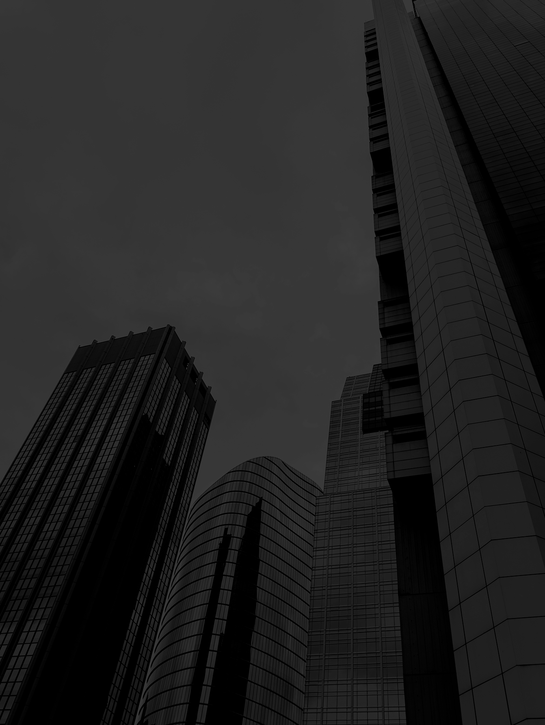
Advertising and Promotion
Advertising
PR
Online
Mercury is the closest planet to the Sun and the smallest one in the Solar System—it’s only a bit larger than our Moon
Venus has a beautiful name and is the second planet from the Sun. It’s terribly hot, even hotter than Mercury
Despite being red, Mars is a cold place, not hot. It’s full of iron oxide dust, which gives the planet its reddish cast

Slide 10
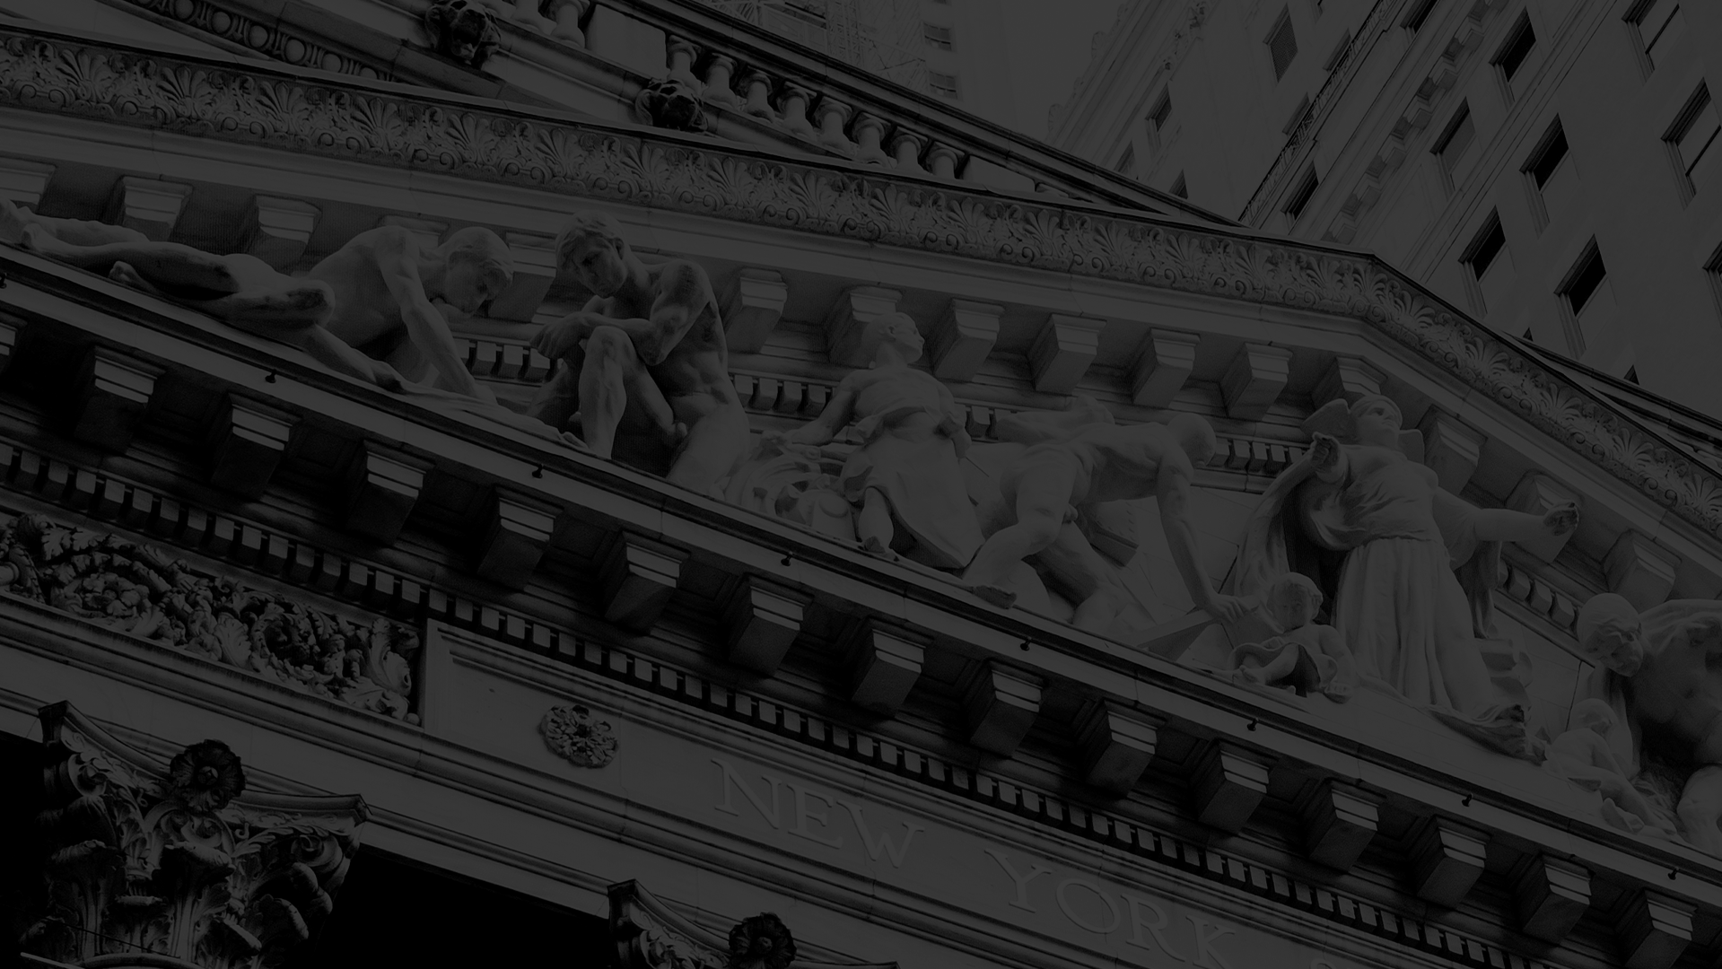
Thank you for your time!
Made by:
Dávid Kálmán
Gábor Roncz
Kornél Vass

Slide 11
...and our sets of editable icons
You can resize these icons without losing quality.
You can change the stroke and fill color; just select the icon and click on the paint bucket/pen.
In Google Slides, you can also use Flaticon’s extension, allowing you to customize and add even more icons.

Slide 12
Educational Icons
Medical Icons

Slide 13
Business Icons
Teamwork Icons

Slide 14
Help & Support Icons
Avatar Icons

Slide 15
Creative Process Icons
Performing Arts Icons

Slide 16
Nature Icons

Slide 17
SEO & Marketing Icons

